Slide 1





Singular and plural
Chapter 1, lesson 3
-

Slide 2
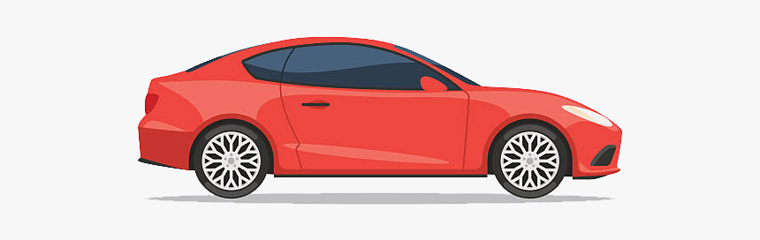


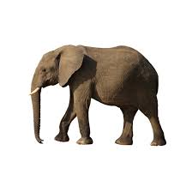
SINGULAR AND PLURAL
SINGULAR/ Singular
PLURAL/ Plural
Car- Carro
Cars - Carros
Book-Libro
Books – Libros
Elephant - Elefante
Elephants - Elefantes

Slide 3
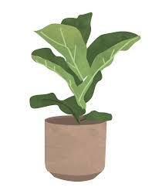
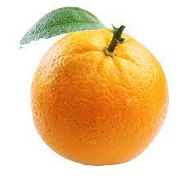
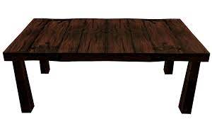

A – AN = 1
1
SINGULAR
PLURAL
A
Book — Libro
Car — Carro (o coche / auto)
Plant — Planta
Table — Mesa
Orange — Naranja
Apple — Manzana
Elephant — Elefante
Books — Libros
Cars — Carros (o coches / autos)
Plants — Plantas
Tables — Mesas
Oranges — Naranjas
Apples — Manzanas
Elephants — Elefantes

Slide 4
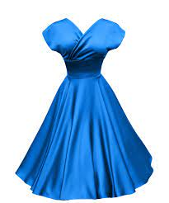
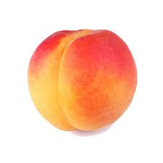

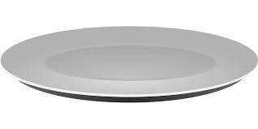
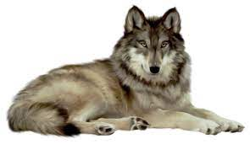
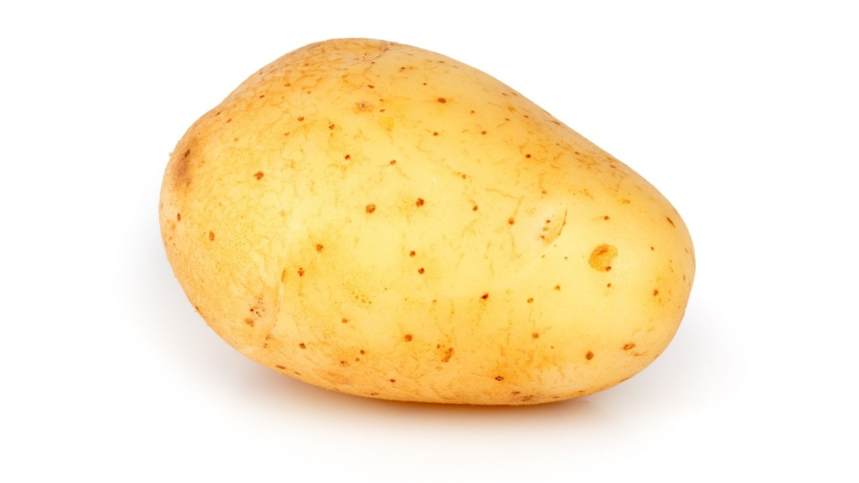

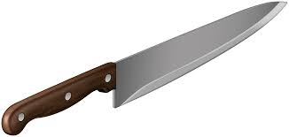
SPECIAL ENDINGS
SINGULAR
2
A
Dress — Vestido
Dish — Plato
Peach — Durazno (o melocotón)
Box — Caja
Potato — Papa (o patata)
Wolf — Lobo
Knife — Cuchillo
City — Ciudad
Toy — Juguete
PLURAL
Dresses — Vestidos
Dishes — Platos
Peaches — Duraznos (o melocotones)
Boxes — Cajas
Potatoes — Papas (o patatas)
Wolfs — Lobos ✅ (en inglés correcto sería Wolves)
Knifes — Cuchillos ✅ (en inglés correcto sería Knives)
Cities — Ciudades
Toys — Juguetes

Slide 5
TEST
SINGULAR
PLURAL
A
bus
baby
leaf
hero
fox
thief
party
family
echo
shelf
story
hobby
buses
babies
leaves
heroes
foxes
thieves
parties
families
echoes
shelves
stories
hobbies

Slide 6
EXCEPTIONS
Article
-
SINGULAR
PLURAL
3
Man
Woman
Person
Child
Foot
Tooth
Mouse
Ox
Men
Women
People
Children
Feet
Teeth
Mice
Oxen

Slide 7
TEST
SINGULAR
PLURAL
An
Eagle
Beach
Day
Country
Man
Desk
Boy
Watch
Foot
Person
Key
Eel
Eagles
Beaches
Days
Countries
Men
Desks
Boys
Watches
Feet
People
Keys
Eels

Slide 8
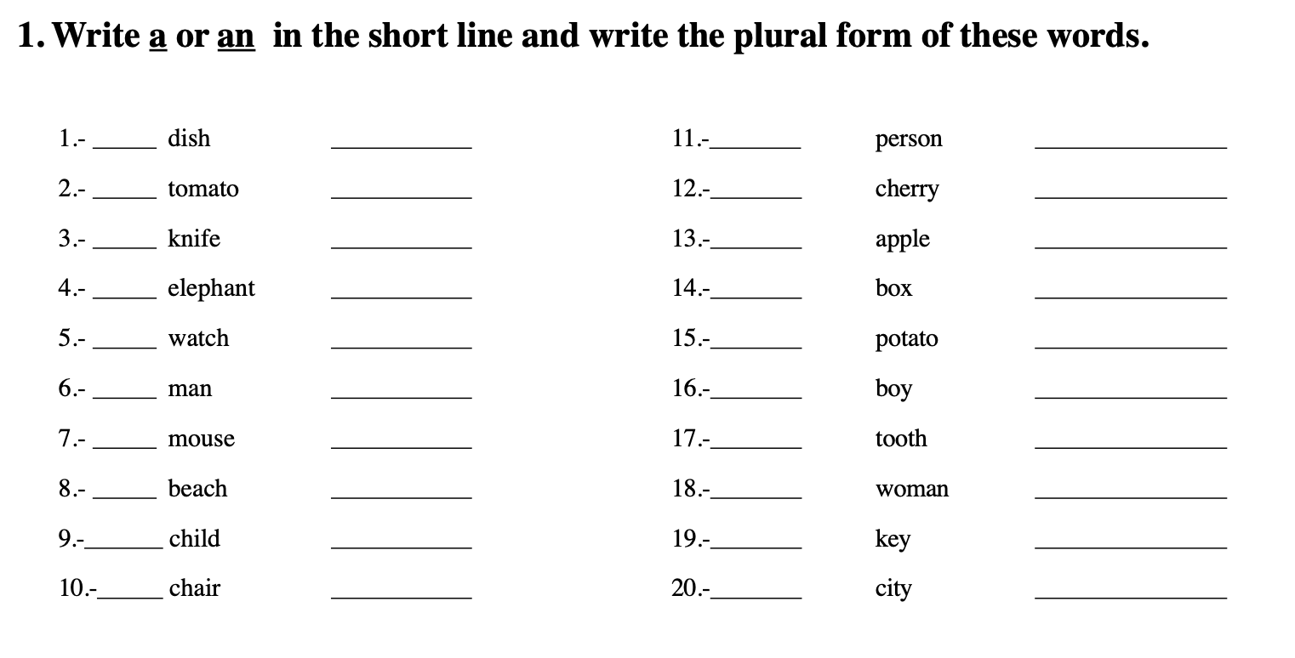
Homework

